Slide 1
Agent Oriented Programming
a presentation on the AOP model and its benefits for software development
by Landon Shumway
BYU-Idaho Society for Artificial Intelligence

Slide 2
“I made up the term 'object-oriented', and I can tell you I didn't have C++ in mind”¹
~ Alan Kay, OOPSLA '97
“I thought of objects being like biological cells and/or individual computers on a network, only able to communicate with messages” ¹
~ Alan Kay

Slide 3
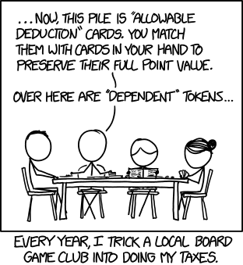
What is AOP?
Agent Oriented Programming is a programming model, such as Object Oriented Programming, that centers its design around Agent classes which work together to perform distinct roles within a program.
AOP seeks to model software development after how humans perform complex tasks in groups.
Source(https://xkcd.com/1566/)

Slide 4

So what is an agent?
An agent can be defined as a module(or class) that contains all the necessary data and methods to perform a unique set of tasks individually, like a human.
An example of this concept is the character Data from Star Trek TNG. An android that acts human, but can perform functions much more quickly and efficiently.
Image source: https://en.wikipedia.org/wiki/Data_(Star_Trek)

Slide 5
What is the main goal of software design?
to reduce complexity
How is this Achieved?
Abstraction: modeling the real world in our classes.
Encapsulation: hiding information that does not need to be seen by other classes (black box)
Cohesion: putting functions together where they work well with each other.
AOP makes it easier to implement these principles.

Slide 6
Abstraction
Do most objects in the real world perform tasks?
then why do we design software that way?
Humans perform tasks in the real world, so it makes sense to design our software classes after a human model. In other words, Agents.

Slide 7
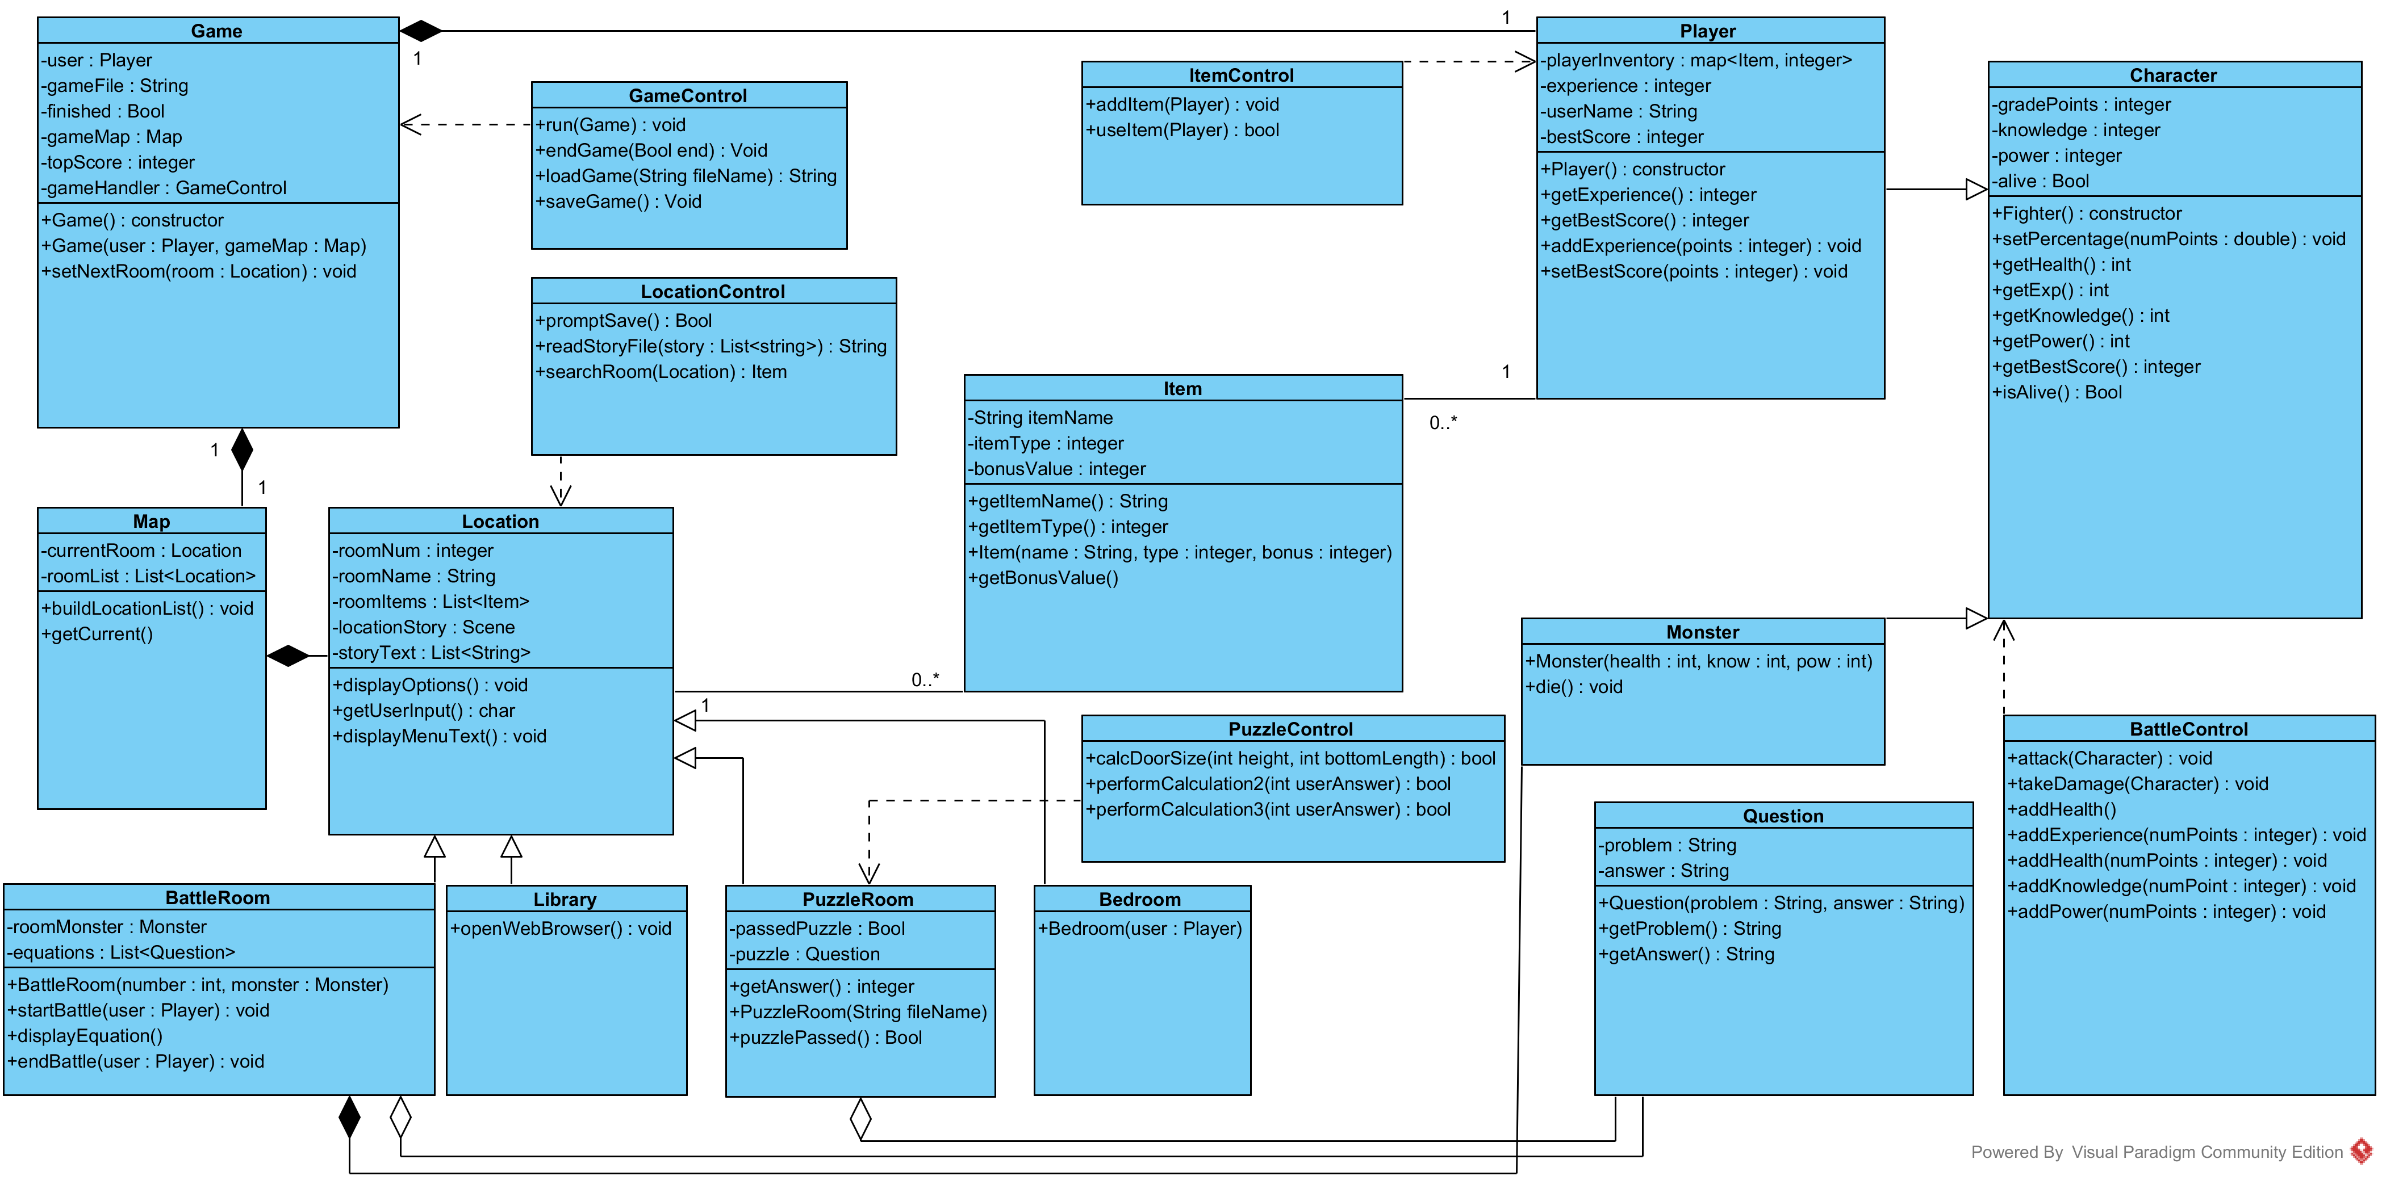
UML of OOP design (MVC model)

Slide 8
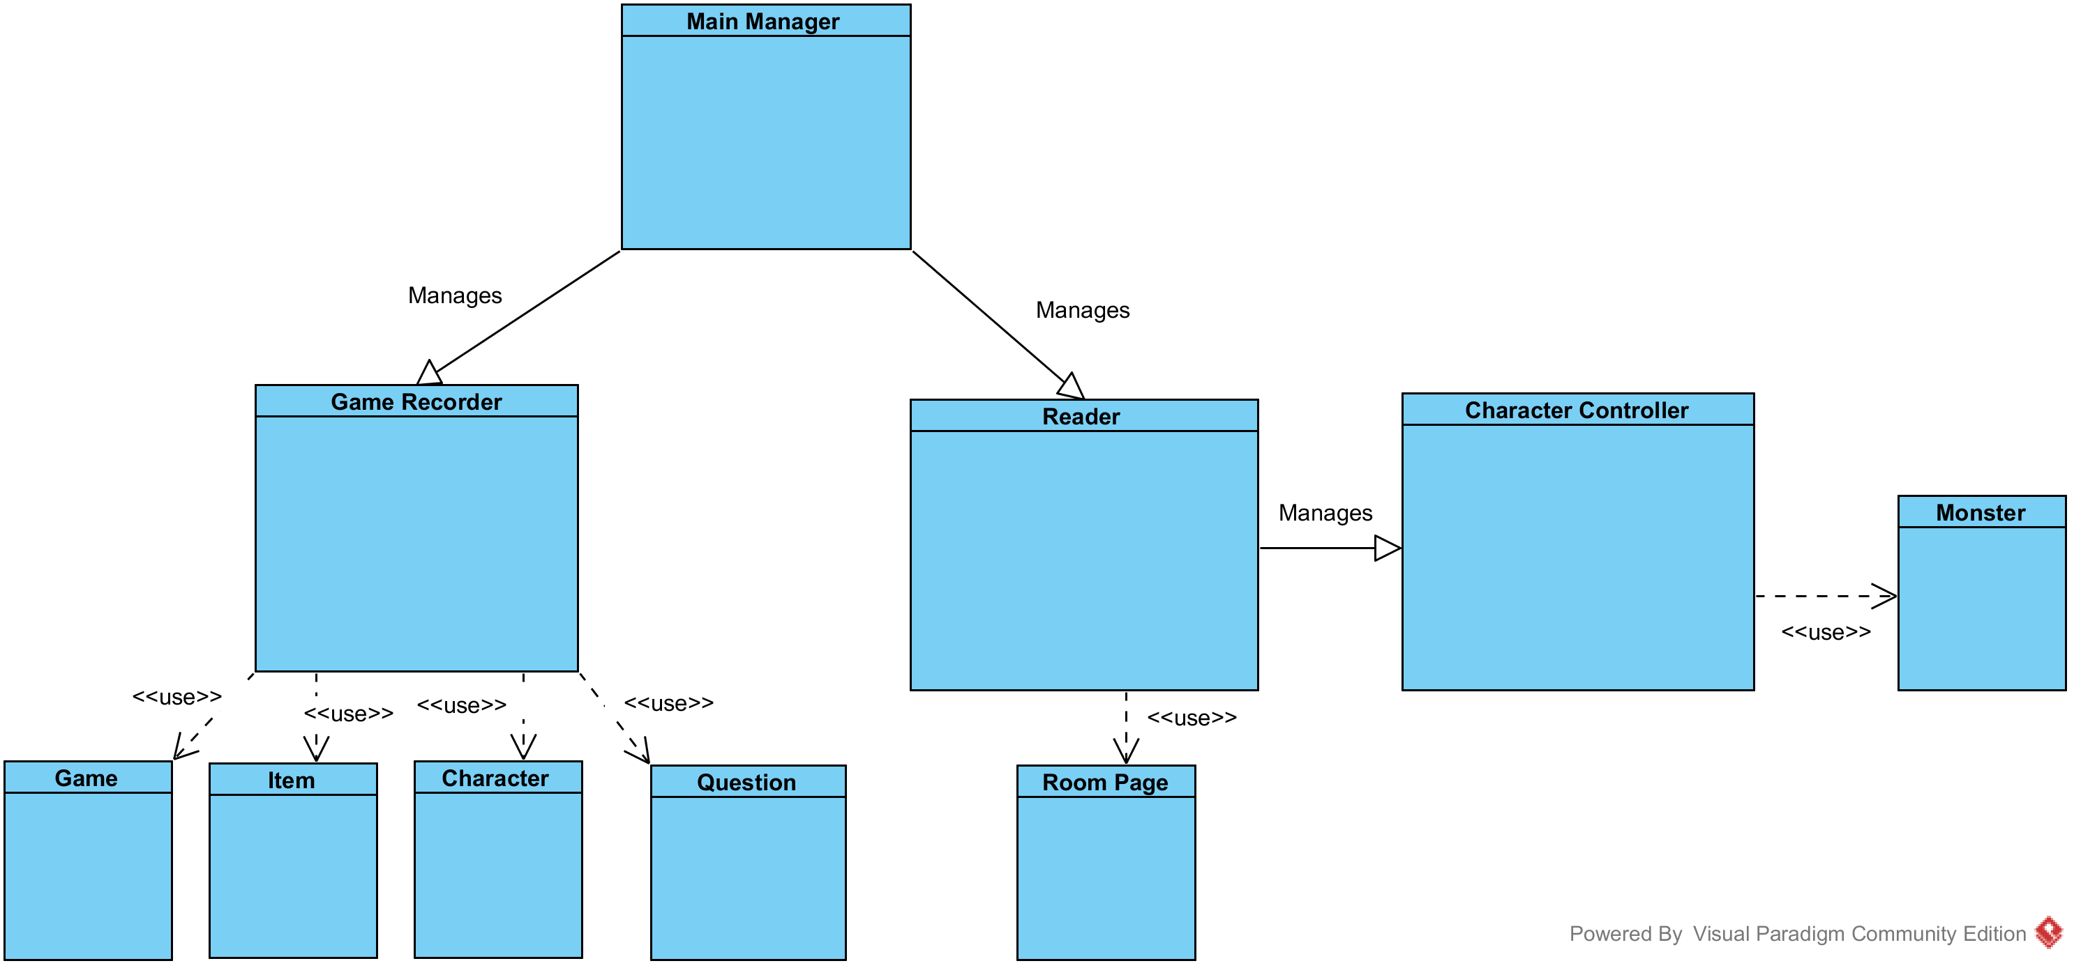
UML of same program, AOP design

Slide 9
Encapsulation
Can a human mind be considered encapsulated?
You can ask people to perform tasks without knowing how they do it.
We can’t forcefully change the information contained within someone’s mind. (ex. their name or birthday) but we can learn useful info from them.
Agents are designed to interact after this concept.
Instead of using “getters” and “setters” like in OOP, agents simply “ask” other agents for any needed information. The data is then copied over into the agent’s “mind”. Now two agents contain two distinct variables which can be freely altered without breaking code.
This model develops data integrity by preventing agents changing the variables of one another unless they specifically ask for such information.

Slide 10
Cohesion
Can the human body be considered cohesive?
- We have the necessary parts to perform complex tasks fluidly.
- Our organs work together to allow our function as a whole
By designing agents with certain tasks in mind, it makes it easier for us to determine which parts an agent will need to accomplish said tasks.

Slide 11

Decoupling and Scalability
Why can’t we build software like we build with block pieces?
Unfortunately AOP does not make software design as easy as this concept, but it gets us closer to this way of building in several key ways.
Other than constructors, There are no parameters passed in AOP.
Agents do not have dependencies in code with one another (unless they are managers).
Agents share a uniform interface, allowing new features to be easily added by plugging in new agents to existing AOP software.
Image source: (https://pixabay.com/en/lego-lego-duplo-building-built-190704/)

Slide 12
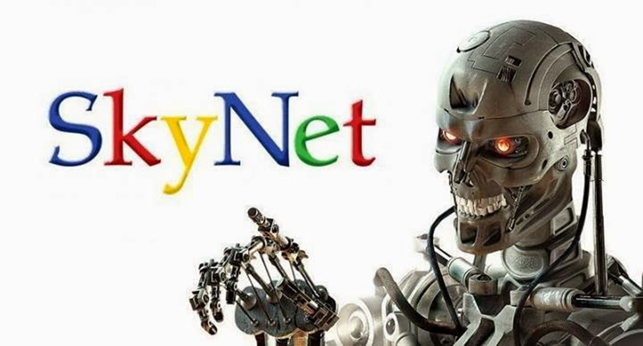
What does this have to do with Artificial Intelligence?
When you divide your program into agents with goal-oriented tasks, you set up the foundation for software that can learn how to improve its performance during runtime, and adapt to its environment.
Neural networks for task pattern recognition
Agents that can teach one another the optimal solution to a function
Self - updating code
In other words…
2

Slide 13
Our semester project: Developing a framework library
This semester (fall 2017) we will be building a library that implements AOP design in order to make software easier and safer to develop.
You have the opportunity to contribute to the details of how this model could and will work in actual software.
Such details include:
- how an agent class interfaces with and learns from an environment class
- how agents can learn from each other to complete tasks at runtime
- how agents can be trained to handle new errors gracefully and intelligently

Slide 14
For a working example…
Please check out our bot-arena-3 project on our society’s Github: https://github.com/sai-byui/bot-arena-3
This project was refactored to implement an AOP design in python.

Slide 15
Some differences between OOP and AOP
OOP | AOP
Objects contain both member variables and functions that can be called on by other classes. ( ex. glass.pourContents(Liquid juice) ) | Only Agents can perform functions. Objects simply hold variables that can be used by Agents. ( waiterAgent.pourGlass() )
Object classes are generally dynamic, and have multiple instances created. | Agent classes are always static, and only one instance of each agent is created for the entire program.
Objects share traits and methods through inheritance to avoid redundant code. | Avoids redundant code by dividing similar tasks to the appropriate Agent. Agents only inherit from the parent agent class, not other agents.
Allows for public and private variables and methods. Data is accessed through getters and setters. | All variables in an agent are private and cannot be directly changed by other agents. Agents “ask” each other for data. Gives programmers the ease of global variables without the dangers.

Slide 16
Sources
1: https://softwareengineering.stackexchange.com/questions/46592/so-what-did-alan-kay-really-mean-by-the-term-object-oriented
2:
http://www.roboticstomorrow.com/article/2017/07/artificial-intelligence-and-skynet/10324

